Slide 1



FINAL PROJECT GROUP 6 Predictive Modeling for Nifty 50 Index Movements DATA PROGRAMMING BDAT1004-23F-10984 Professor Thomas Parker

Slide 2


Team Members
Annite Gee Varghese
(200569332)
Niji Biju
(200567014)
Josmy Ann Jose
(200573250)
Devika Chenkulam

Slide 3

INTRODUCTION
For the project, a complex web application in Python with immersive visualizations of the Nifty 50 index data must be created with PyCharm and the Flask and Django frameworks. Using information gathered from a web API, the program will provide dynamic charts, graphs, and interactive dashboards that will provide users with a comprehensive insight into Nifty's performance trends, sector breakdown, and historical patterns. A user-centric design makes it simple for traders, investors, and market experts to get actionable insights, empowering them to make wise decisions. To facilitate more informed investment decisions and increase the accessibility of complex financial data, the project has made use of modern visualization tools. In the end, our project serves as a conduit between data analytics and the stock market, facilitating improved understanding and tactical decision-making within the Nifty50 context.

Slide 4
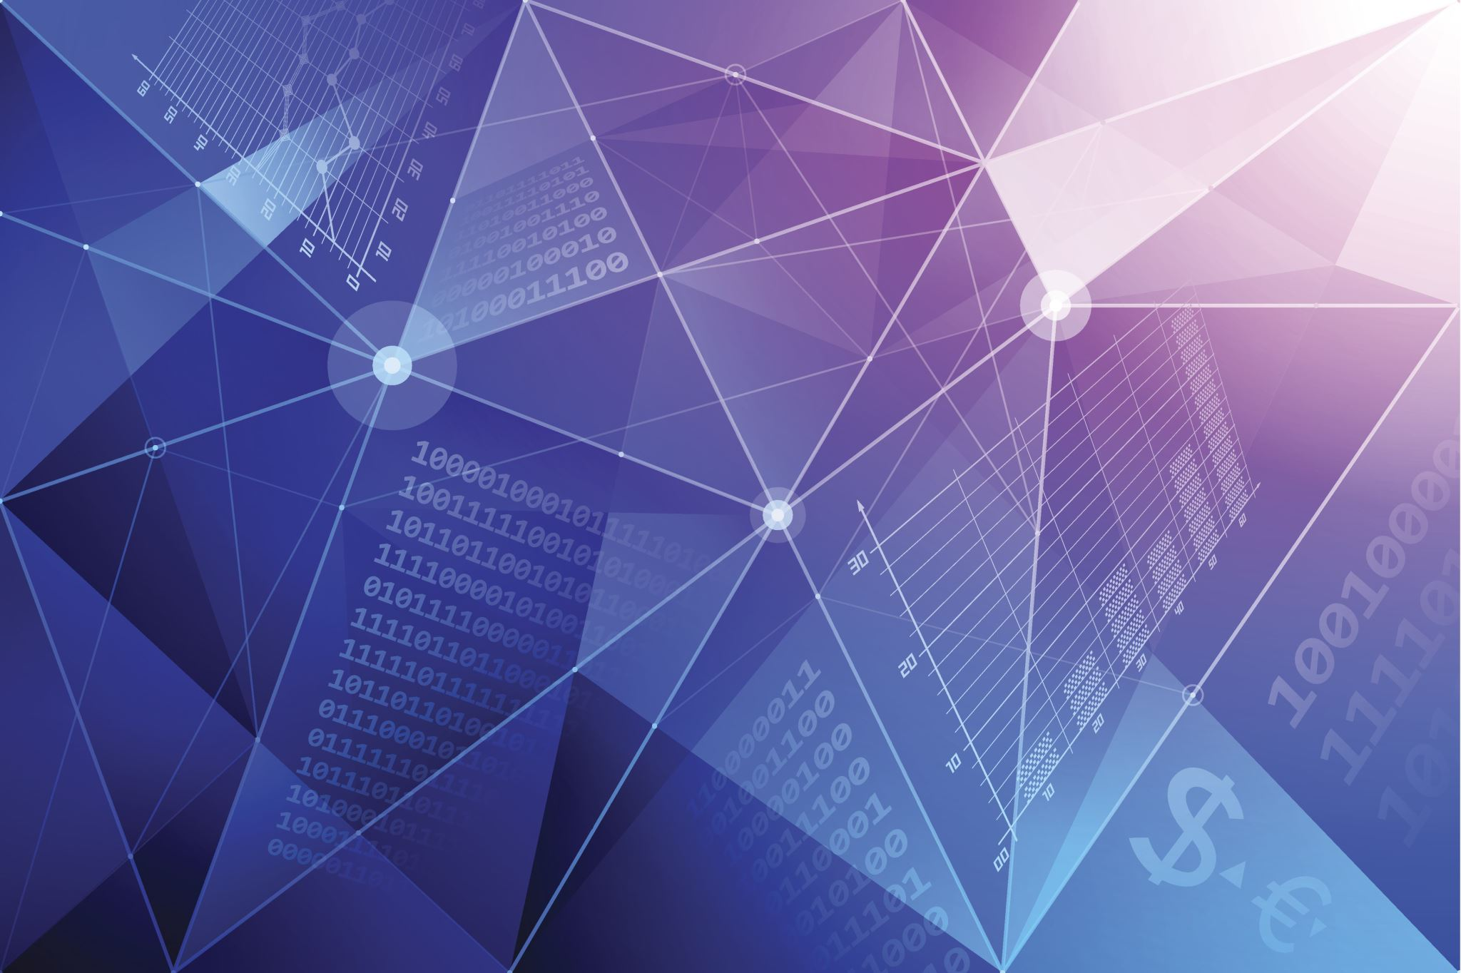
BUSINESS CASE
In this project, the company uses API data extracted from the Rapid API link https://rapidapi.com/suneetk92/api/latest-stock-price to find the change in stock prices in India, as well as high volumes for various stocks and which stocks have higher or lower live prices. These steps are taken to find meaningful insights for trading and investing, as well as a thorough understanding of Nifty's performance trends. Using PyCharm, we were able to extract Python and MongoDB codes using this API. We have contributed solutions to this to meet the requirements of the business case. After collecting data from the API, saving it in the database is necessary to construct visualizations. The website is constructed using Flask, JINJA2, and PyCharm, which are also used to organize and display the visualizations needed to answer the queries and provide the company with a comprehensive study of the Nifty stock market for trading and investment after examining current trends. The data frameworks and extracted queries were visualized as bar charts, line charts, and pie charts on a web interface using Google Charts and JavaScript.

Slide 5

Tools
Python: the main programming language used to write backend code, make API calls, establish a MongoDB connection, and manage the Flask web application.
Flask: It is a Python microweb framework that is used to build and deliver web pages.
MongoDB: The retrieved data from the Nifty stock market API is stored in this NoSQL database.
HTML: It is a markup language that is used to organize the content of webpages.
Jinja2: This engine is used to show Python API data in HTML templates and create HTML content.
Javascript: This language is used to integrate the library of Google charts and produce interactive online visuals.
Google Charts: A JavaScript library for making pie, bar, and line charts, among other types of data visualizations.
PyCharm: An environment for integrated development used to write and run Python programs.
Terminal: A command-line interface is used to control the development server and Python programs.

Slide 6
PROJECT FLOW
Acquiring data from an API
Using Python programs to store the retrieved data in a MongoDB database.
Web application creation using Flask, HTML, Jinja2, and visualization using JavaScript and Google charts
Develop an API

Slide 7
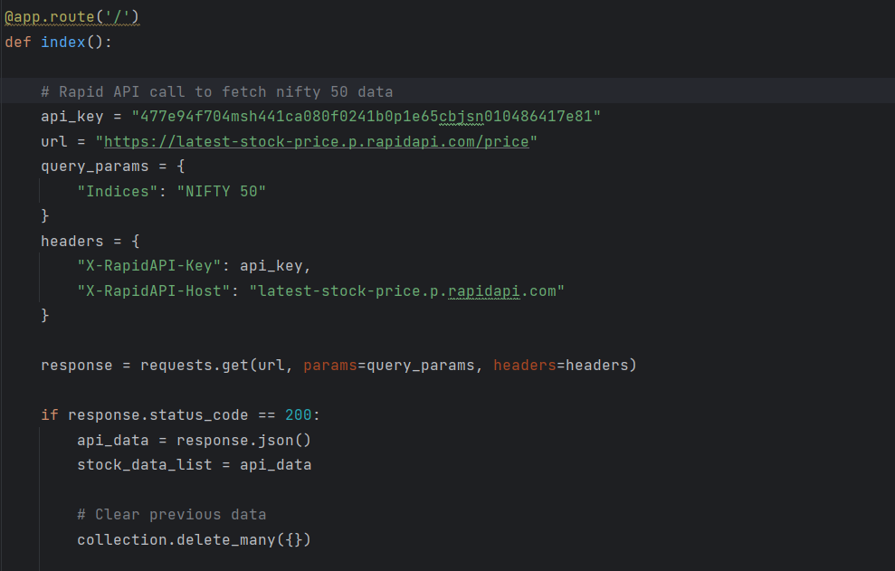
Acquiring data from an API

Slide 8
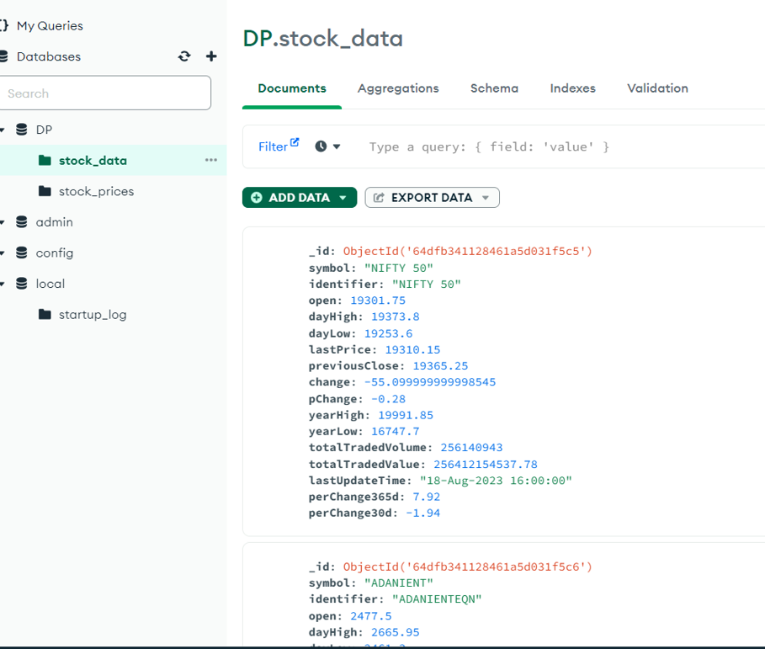
Storing the data in the MongoDB database

Slide 9
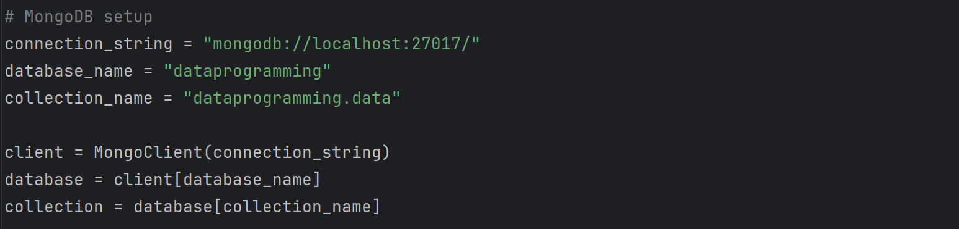
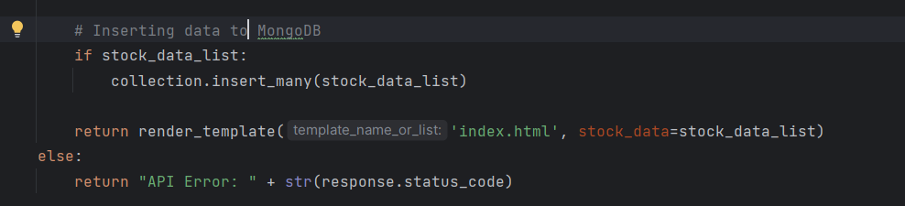

Slide 10
Data Visualization of the stock data
A webpage that visualizes the stock data has been established.
Additionally, we have enhanced the user interface with a few new features.

Slide 11
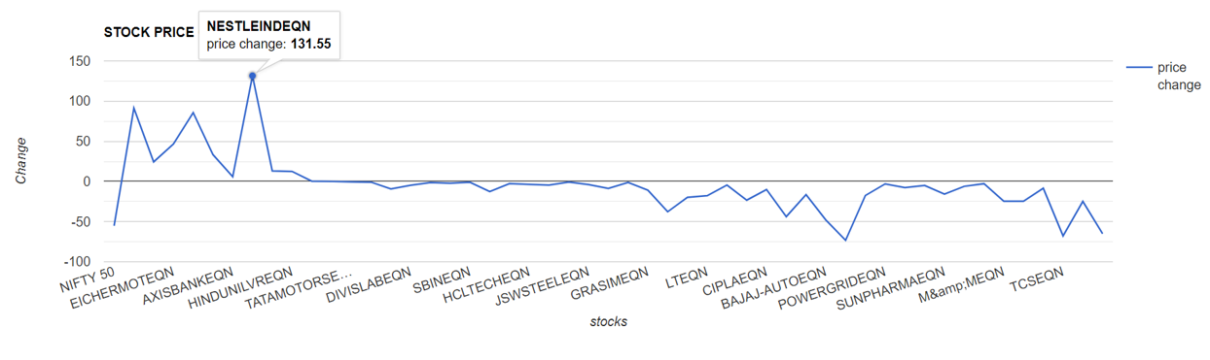
LINE CHART
The price change of a certain stock can also be seen by moving the cursor over it.

Slide 12
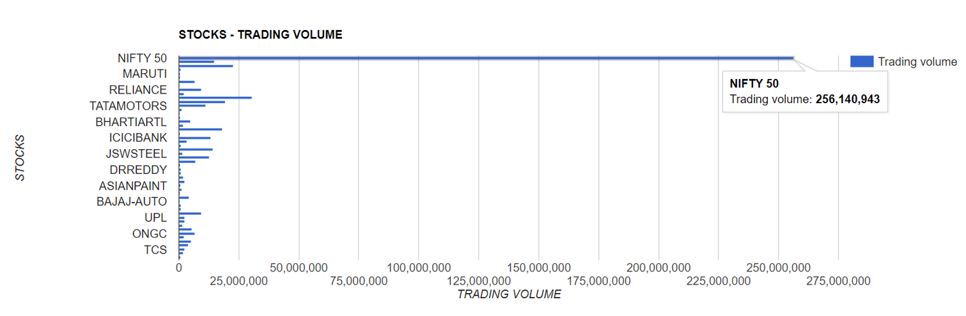
BAR CHART
You can view the stock's current trading volume by navigating to a specific stock line.

Slide 13
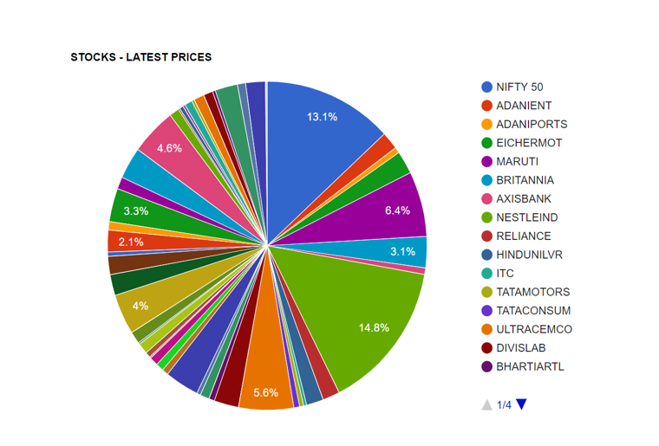
PIE CHART
In the pie chart, each stock's most recent price update is displayed in a different color.

Slide 14
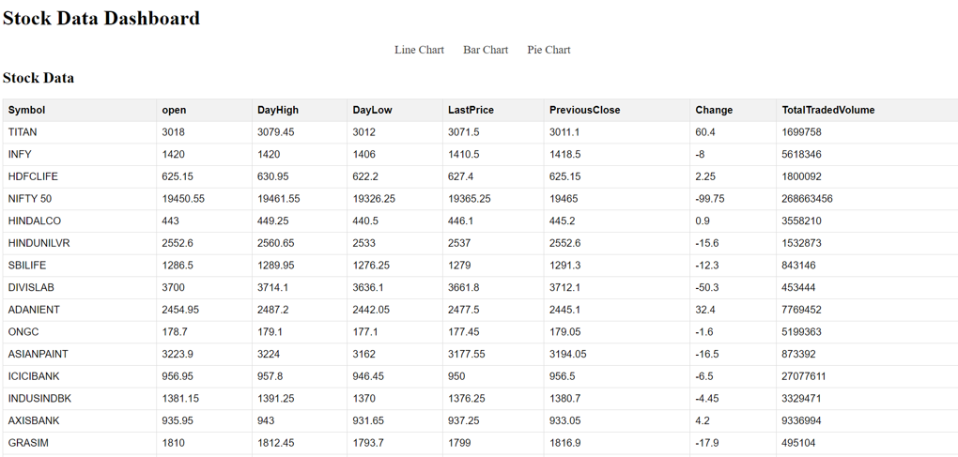
STOCK DATA
We have also developed a feature that displays the stock data for the stocks.

Slide 15
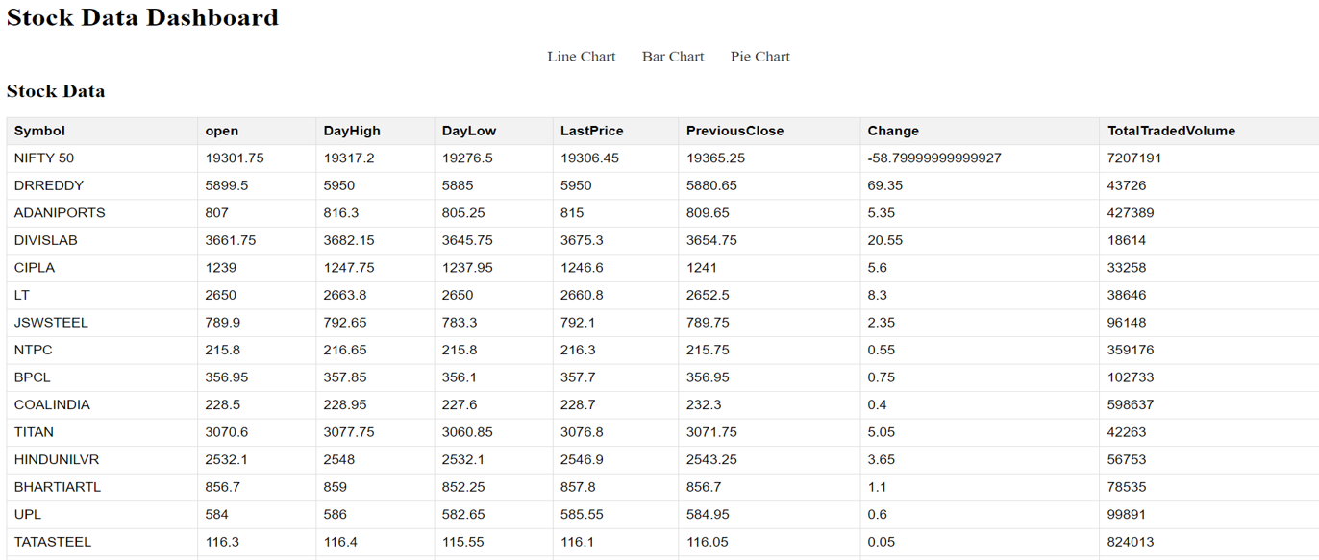

Slide 16
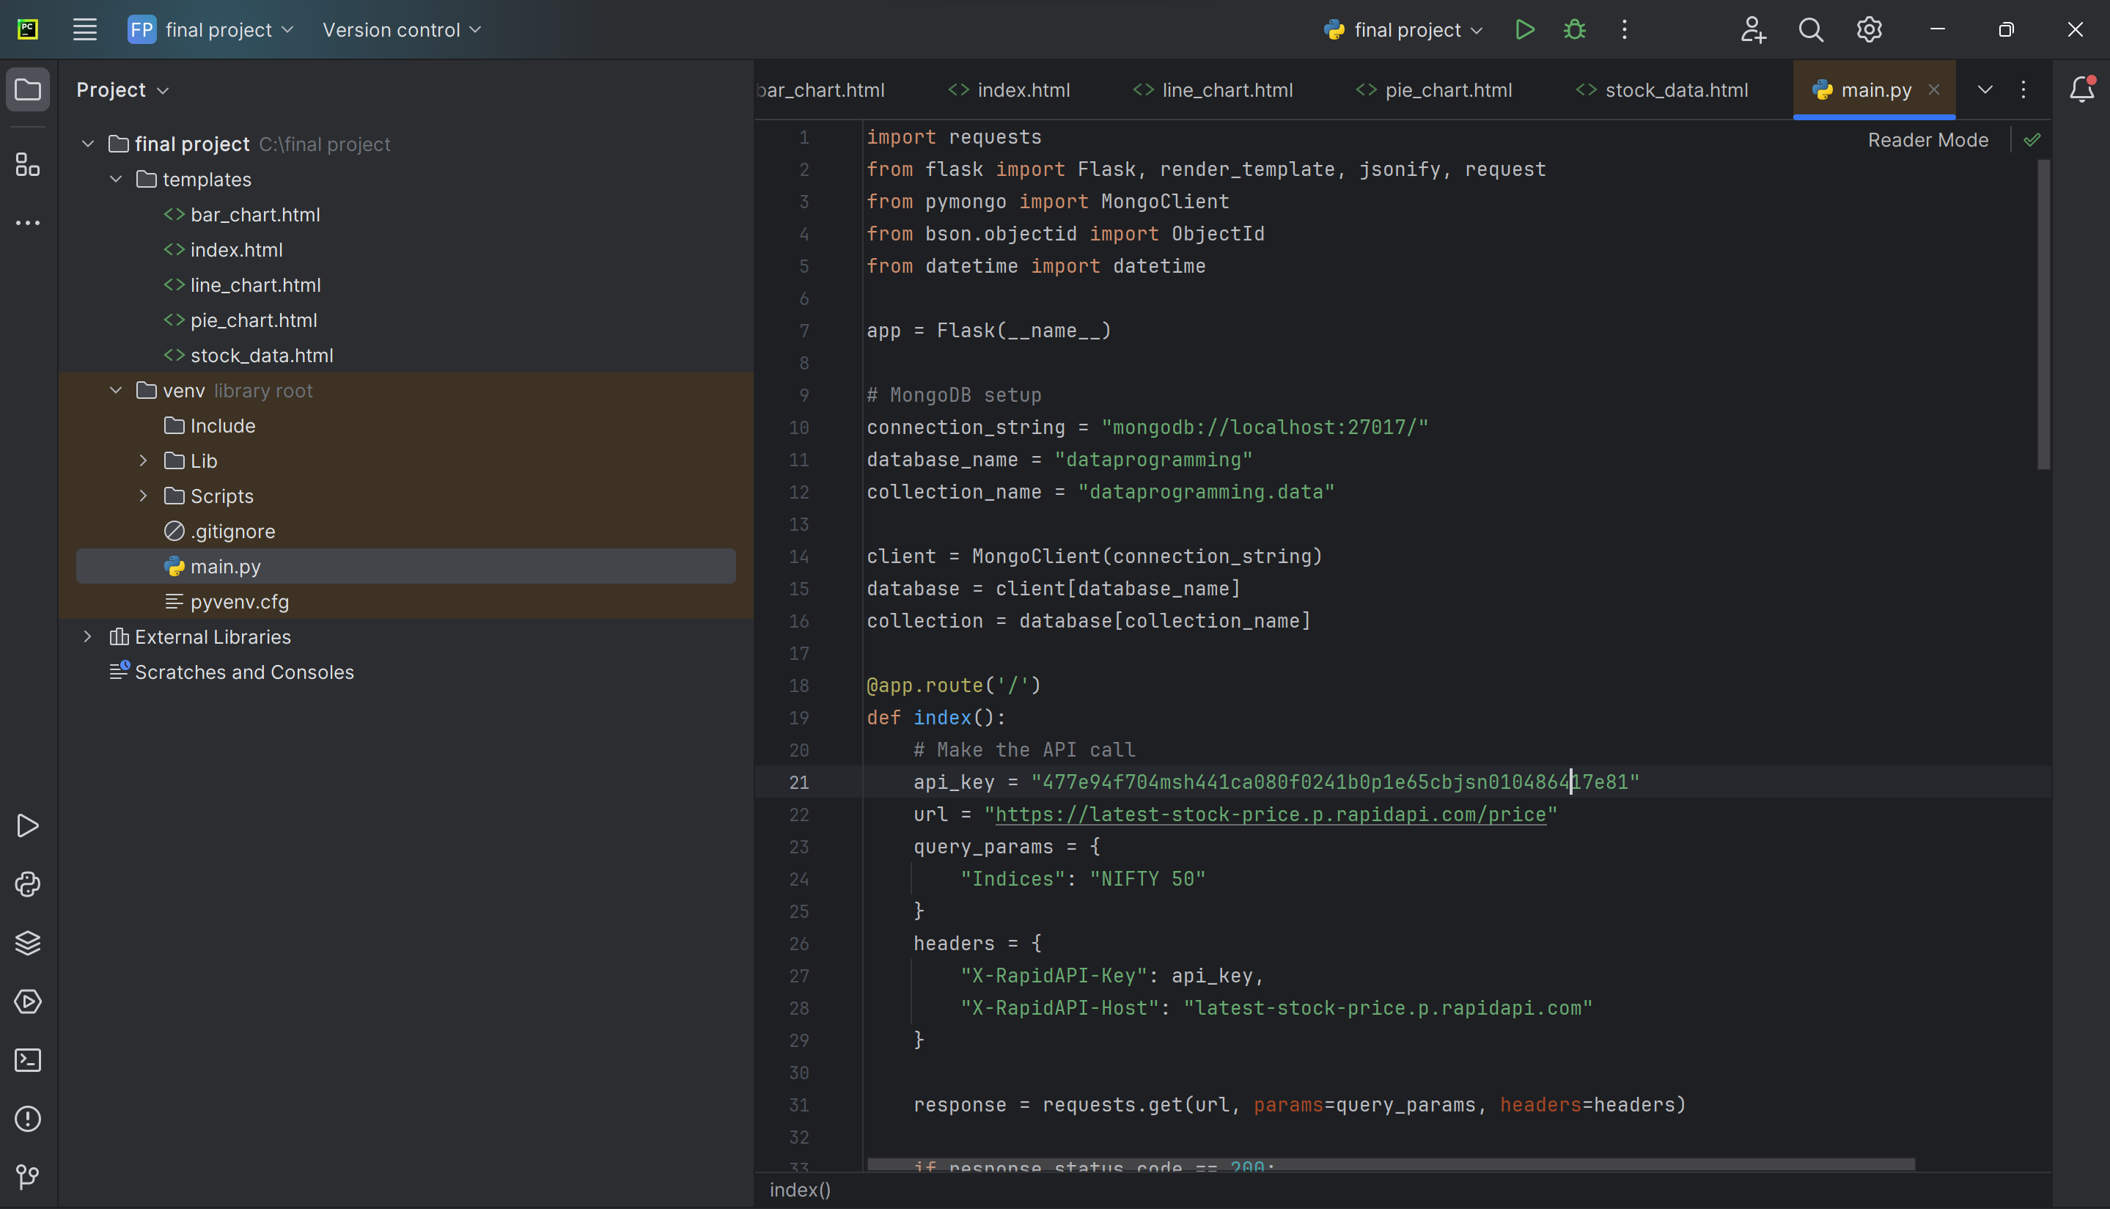

Slide 17
CONCLUSION
In the culmination of our project, we've orchestrated a dynamic symphony of technology and financial acumen, harmonizing predictive modeling and cutting-edge web application development. Through the seamless orchestration of Python, Flask, MongoDB, and an API-driven data pipeline, we've created a robust platform that distills the complexity of Nifty 50 index movements into intuitive visualizations. This culmination empowers traders, investors, and market aficionados with comprehensive insights, bridging the gap between intricate market data and actionable decisions. In addition, has our path from data retrieval to visualization been a technical achievement, but it has also served as a link between data analytics and actual market dynamics. We've created a channel that democratizes financial understanding by fusing complex code and user-centered design, providing a comprehensive perspective of the Nifty 50 index. Our project is moving towards a future where making well-informed decisions is essential to succeed in the constantly changing financial markets, as technology and finance collide.

Slide 18

THANK YOU…..

